Slide 1






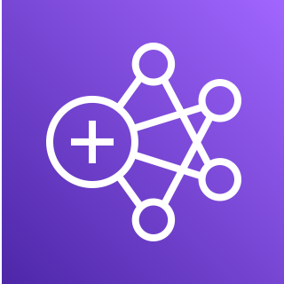







Athena
S3S
L Transformer
GDO
GDS
K data stream
K delivery stream
GC
GC
GP
SJE
GP
S3L
SF
DDB Audit Table Streams-enabled
L -> Lambda
K -> Kinesis
S3L -> S3 Landing Area
S3S -> S3 Staging Area
GC -> Glue Crawler
GP -> Glue Python Shell Job
SJE -> Spark Job on EMR
SF -> Step Function
EB -> EventBridge
DDB -> DynamoDB
GDO -> Glue Data Catalog – orders table
GDS -> Glue Data Catalog – staging_orders table
SNS
EB Rule
L Audit Table Scanner
L Data Publisher
SF
GP
GP
GP
SJE
API Gateway
Redshift Final
Redshift Staging
Capture Order Details (UI)

